Slide 1
Lecture -11
Engineering Mechanics
Analysis of Structures

Slide 2
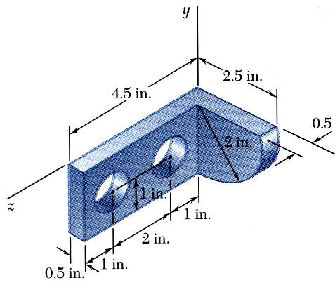
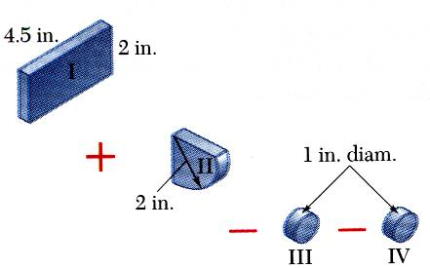
Applications (Centroid of volume)
SOLUTION:
Form the machine element from a rectangular parallelepiped and a quarter cylinder and then subtracting two 1-in. diameter cylinders.
Locate the center of gravity of the steel machine element. The diameter of each hole is 1 in.

Slide 3
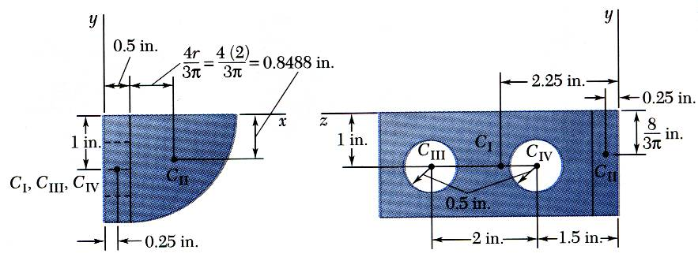
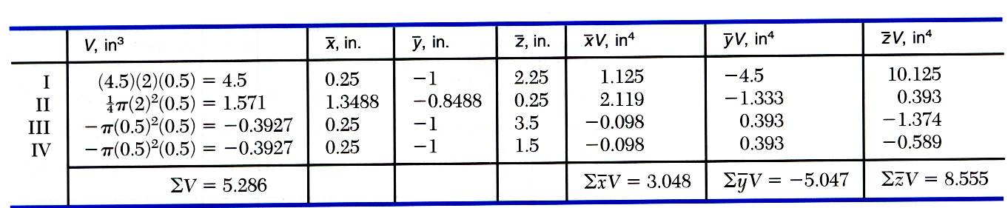
Applications (Centroid of volume)

Slide 4
Applications (distributed forces)
A’
A
1.8 m
1.2 m
B’
B
When closed, a vertical sluice gate, is supported along the lines AA’ and BB’ normal to the plane of the figure and is submitted to the action of water pressure from both sides, as indicated. If the weight of water per unit volume is w=10 kN/m³, find the intensities P_{a} and P_{b} of the reaction developed by the support, assuming them to be uniformly distributed along AA and BB.

Slide 5
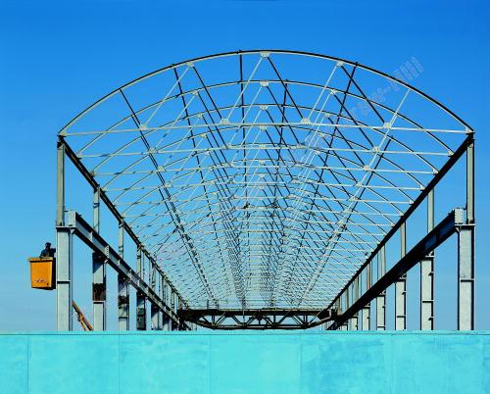
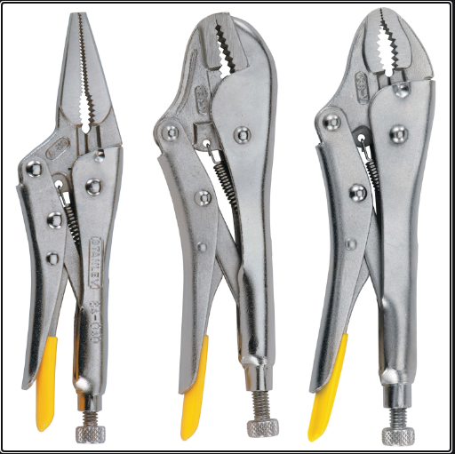
Applications
Design of support structures requires knowledge of loads, or forces, that each member of the structure will experience.

Slide 6
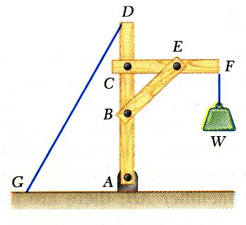
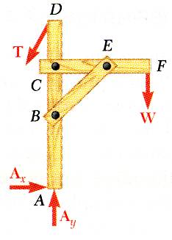
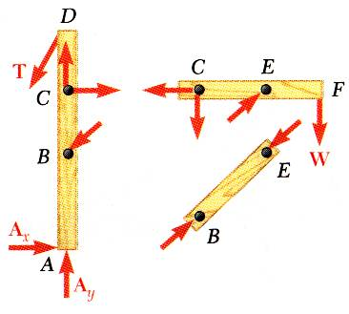
Introduction
For the equilibrium of structures made of several connected parts, the internal forces as well the external forces are considered.
In the interaction between connected parts, Newton’s 3rd Law states that the forces of action and reaction between bodies in contact have the same magnitude, same line of action, and opposite sense.

Slide 7
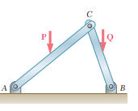
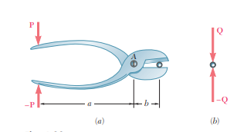
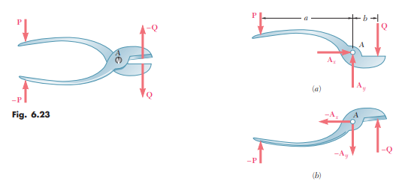
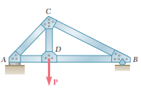
Types of Engineering Structures: Truss, Frames and Machines
Truss: A system of bars (all two force members), joined together at their ends in such a way that they form a rigid frame work. The forces are applied at the joints only.
Frame: They differ from the truss principally in one aspect: the various members are not limited to the action of forces applied at their ends only.
Machine: Structure consisting of different parts (called links) whose principal function is to modify and/ transmit forces.
Truss
Frame
Machine

Slide 8
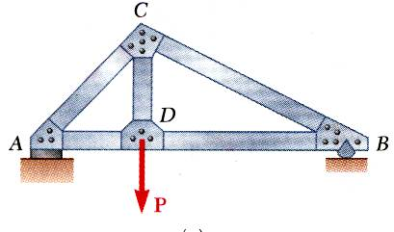
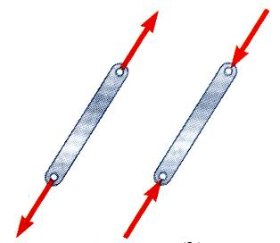
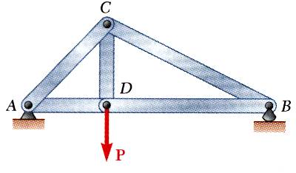
Truss: Introduction
Truss: A system of bars (all two force members), joined together at their ends in such a way that they form a rigid frame work. The forces are applied at the joints only.
A truss consists of straight members connected at joints. No member is continuous through a joint.
Most structures are made of several trusses joined together to form a space framework. Each truss carries those loads which act in its plane and may be treated as a two-dimensional structure.
Bolted or welded connections are assumed to be pinned together. Forces acting at the member ends reduce to a single force and no couple. Only two-force members are considered.
When forces tend to pull the member apart, it is in tension. When the forces tend to compress the member, it is in compression.

Slide 9
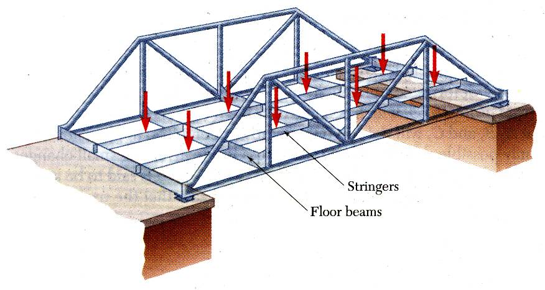
Truss: Introduction
Members of a truss are slender (thin and small) and not capable of supporting large lateral loads. Loads must be applied at the joints.

Slide 10
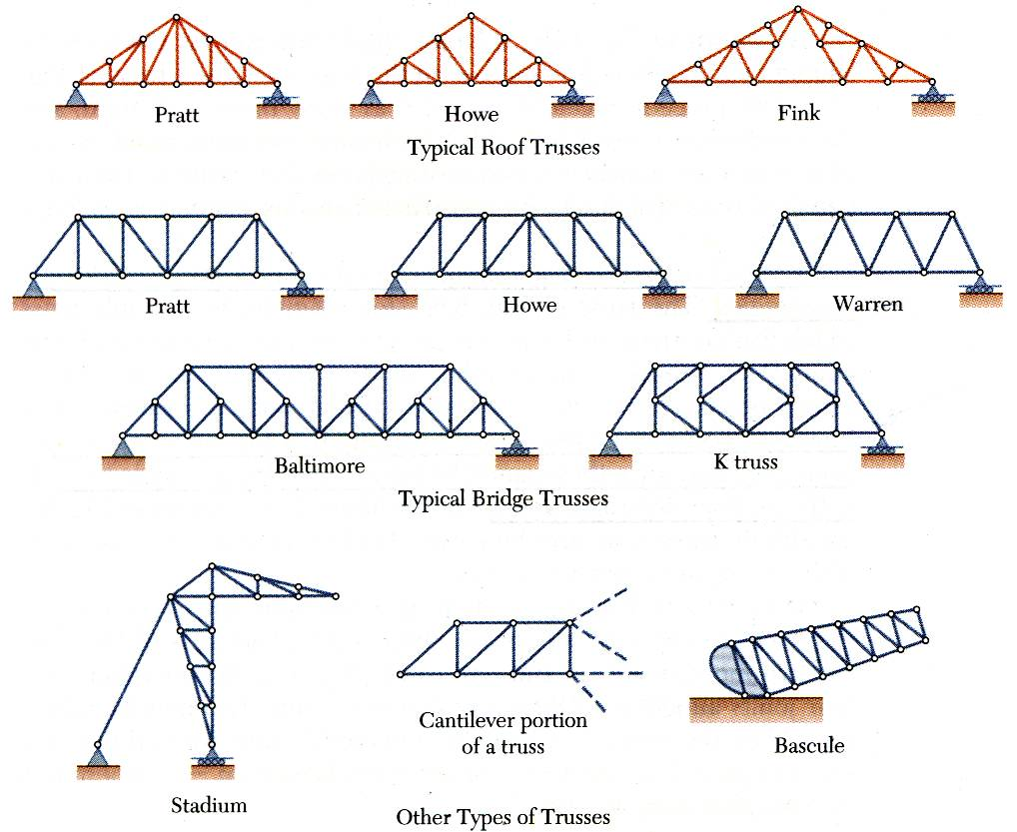
Types of Trusses

Slide 11
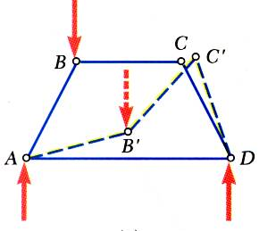
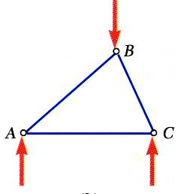
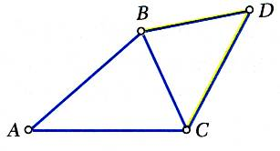
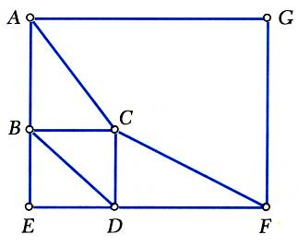
Rigid and Simple Trusses
A rigid truss will not collapse under the application of a load.
A simple truss is constructed by successively adding two members and one connection to the basic triangular truss.

Slide 12
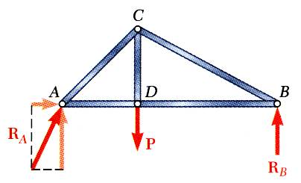
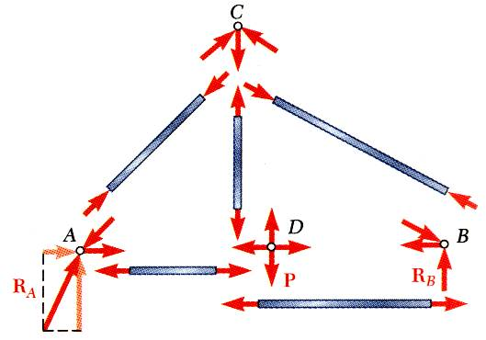
Analysis of Trusses: Method of joints
Dismember the truss and create a free body diagram for each member and pin.
Conditions for equilibrium for the entire truss can be used to solve for 3 support reactions.
The two forces exerted on each member are equal, have the same line of action, and opposite sense.
Forces exerted by a member on the pins or joints at its ends are directed along the member and equal and opposite.
Conditions of equilibrium are used to solve for 2 unknown forces at each pin (or joint), giving a total of 2n solutions, where n=number of joints. Forces are found by solving for unknown forces while moving from joint to joint sequentially.

Slide 13
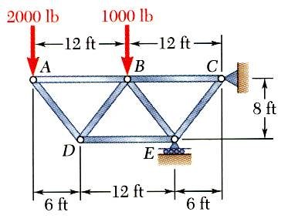
Solution to Problem 1
Using the method of joints, determine the force in each member of the truss.

Slide 14
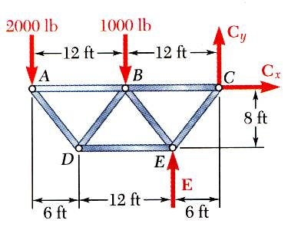
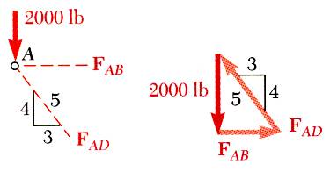
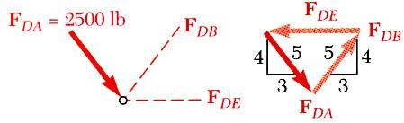
Solution to Problem 1

Slide 15
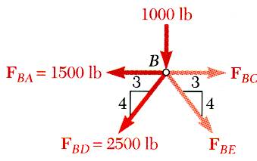
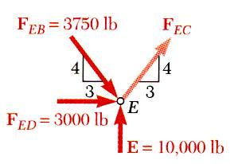
Solution to Problem 1

Slide 16
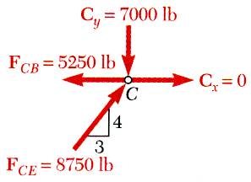
Solution to Problem 1

Slide 17




Analysis of Trusses: Method of joints
P
a
a
a
A
B
$${30}^{0}$$
$${60}^{0}$$
C

Slide 18
Acknowledgement
NPTEL lectures on Engineering Mechanics
Beer & Johnston, Vector Mechanics for Engineers
Meriam & Kraige, Engineering Mechanics
Problems taken from internet sources
Timoshenko & Young, Engineering Mechanics

